Slide 1

Year One Welcome Meeting

Slide 2
The Year One Team:
Kate Vaughan: Bat Class Teacher (Monday, Tuesday, Thursday) / Assistant Head
Fiona Cianciola: Bat Class Teacher (Wednesday and Friday)
Lisa Campbell: Woodpecker Teacher (Monday, Tuesday, Wednesday)
Jennie Shipton: Woodpecker Teacher (Thursday, Friday)
Claire Revans: Full time HLTA In Woodpecker class
Chika Waterfield: Bat Class TA (Mornings)
Rachel Anderson:Bat Class TA (Afternoons on Monday, Tuesday, Friday)
Roz Markham: Intervention support.

Slide 3
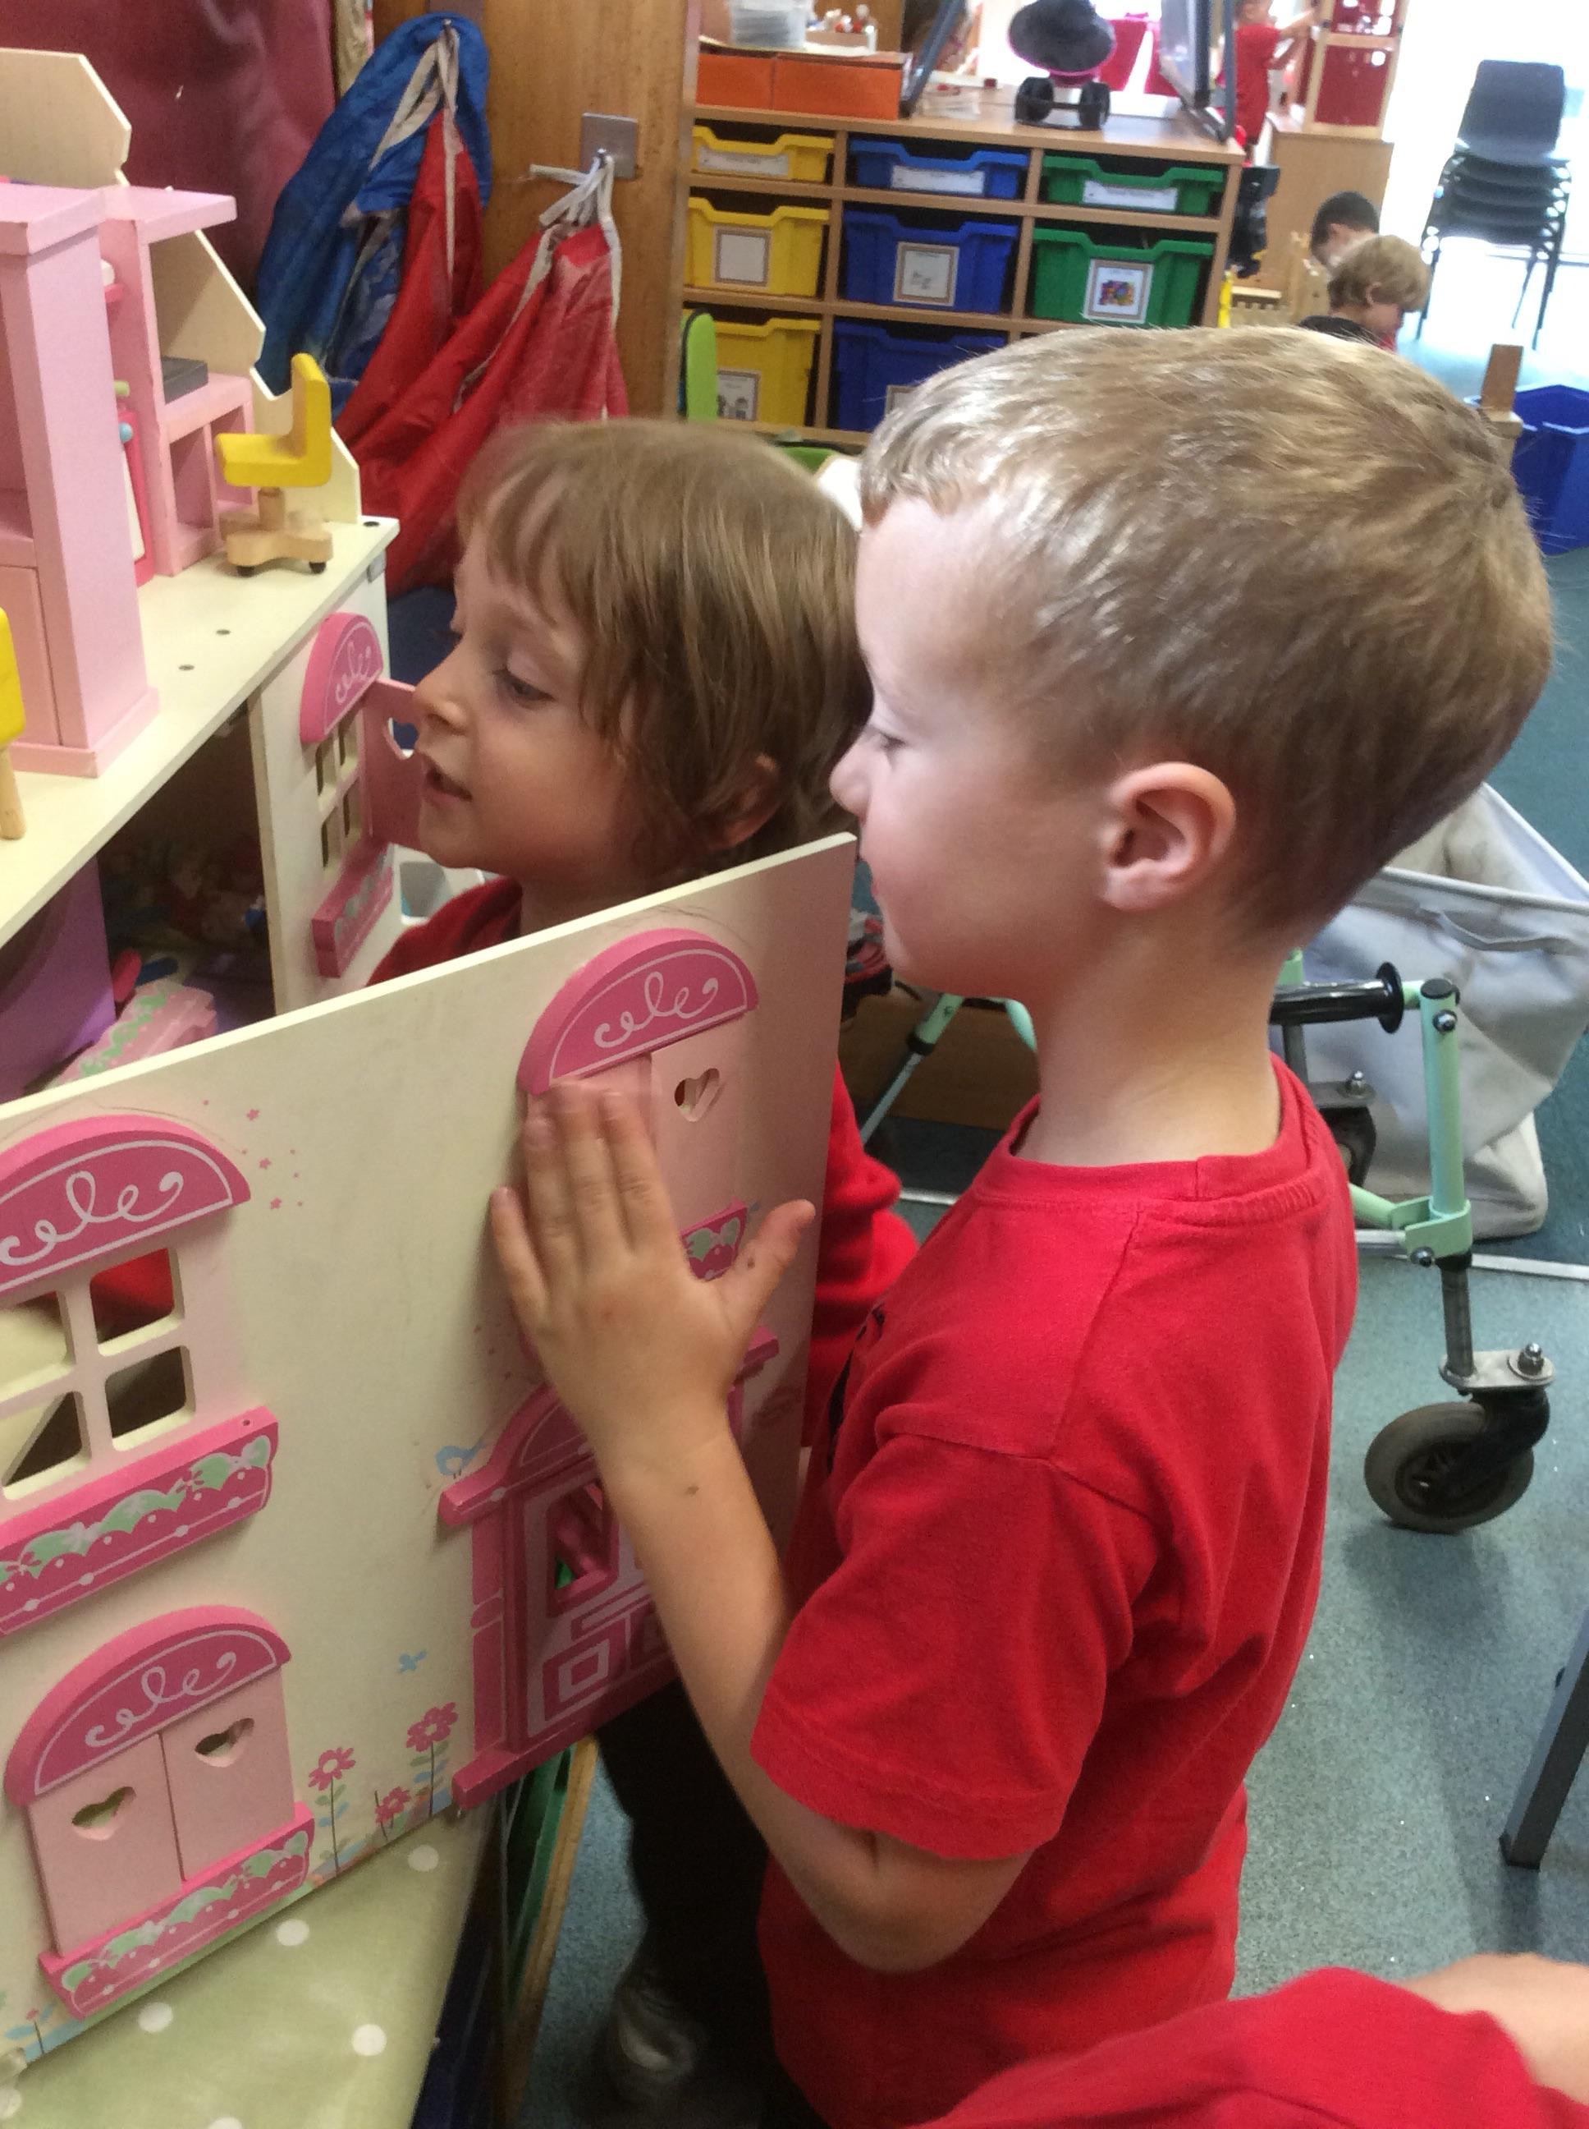
Our School Day

Slide 4
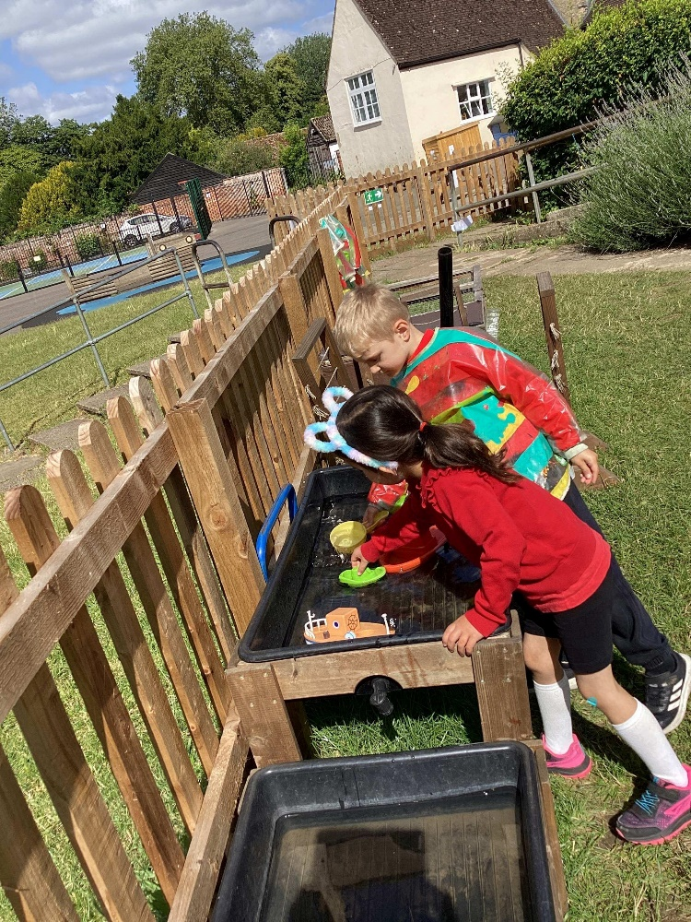
8:40 Dough Disco/ Morning Activity
8:55 Assembly
9:15 Phonics
10:00 English
11:00 Maths
12:00-13:00 Lunch Time
13:00-15:15 Topic learning, Guided Reading, Exploring and Story Telling/Singing.

Slide 5
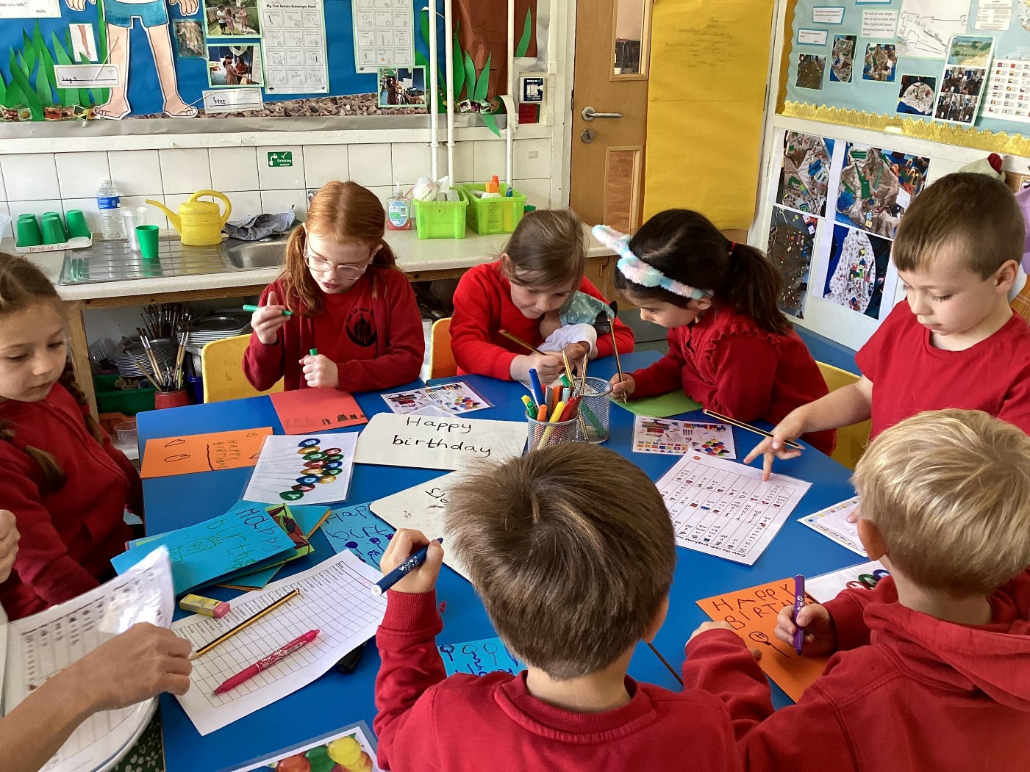

Woodpecker: Reading Book Swap and Library on Thursday
Bat: Reading Book Swap on Monday
Library on Wednesday
Please Send your Bat/Woodpecker to school in PE kit on…
Woodpecker: Monday and Tuesday
Bat: Wednesday and Friday.

Slide 6
We are inspired
We are performers
We are inventors
We are family
We are explorers
We are champions

Slide 7
History
Looking at famous people that have inspired us, having an impact on the world.
Looking at how people lived throughout history
Science
Autumn
Identifying species
Identifying common plants.
Literacy
Drawing Club – three weeks
Letter writing
Writing in role
Story writing
Autumn Term A
We are inspired
Music
Charanga: My Musical Heartbeat
Art
Looking at portraits and the way they have changed through time.
Look at Picasso and Hockney for inspiration and create our own.
RE
Christianity: Why is belonging to God and the church family important to Christians? Love and generosity: link with the people we are inspired by and why.
Who inspires our children?
Maths
Place value within 10.
Addition and Subtraction within 10.
NCETM

Slide 9
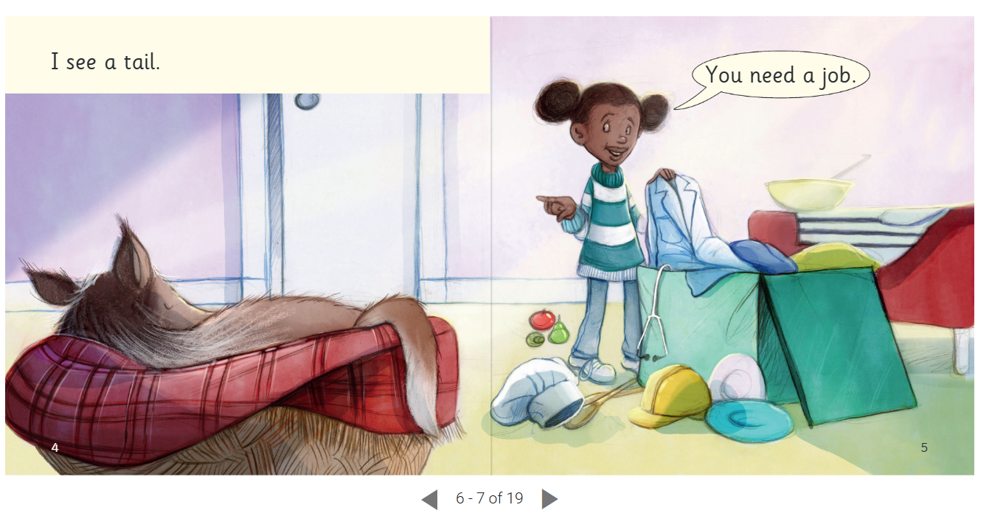


Slide 10
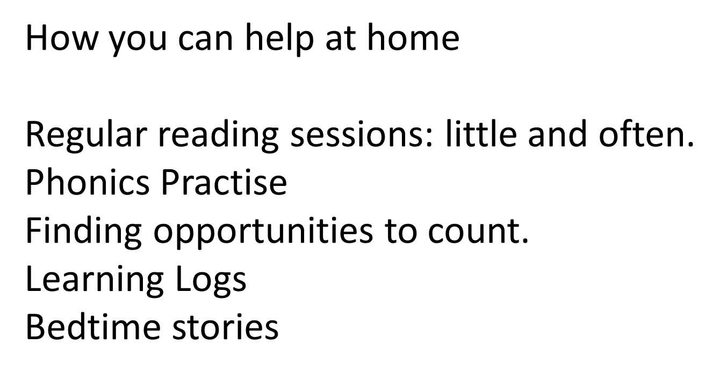

Slide 11

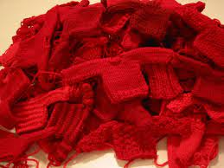
What to bring to school
Named Water bottle
Book Bag
Weather appropriate clothing
Sunscreen when needed

Slide 12

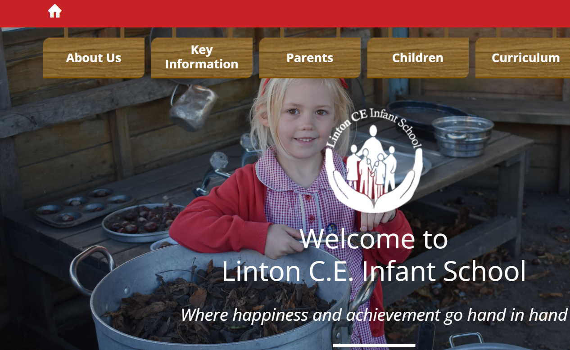
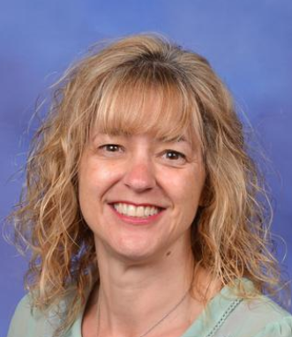
Office: Absence or a change of pick up / contact detail/urgent messages
Class Dojo: General messages. Website: Topic and Learning Log information.

